Slide 1
Adversarial Attacks and Defenses on Fashion MNIST
FGSM, PGD, and MAT in Action
Simran Dalvi (202318042)
Aditya Tripathi (202318046)

Slide 2
Introduction to Adversarial Attacks
An adversarial attack is a technique used to intentionally deceive a machine learning model by adding subtle, often imperceptible, perturbations to input data.
These small changes cause the model to make incorrect predictions, exposing vulnerabilities in model robustness.

Slide 3
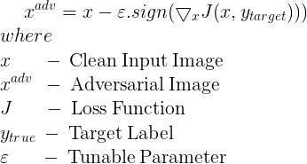
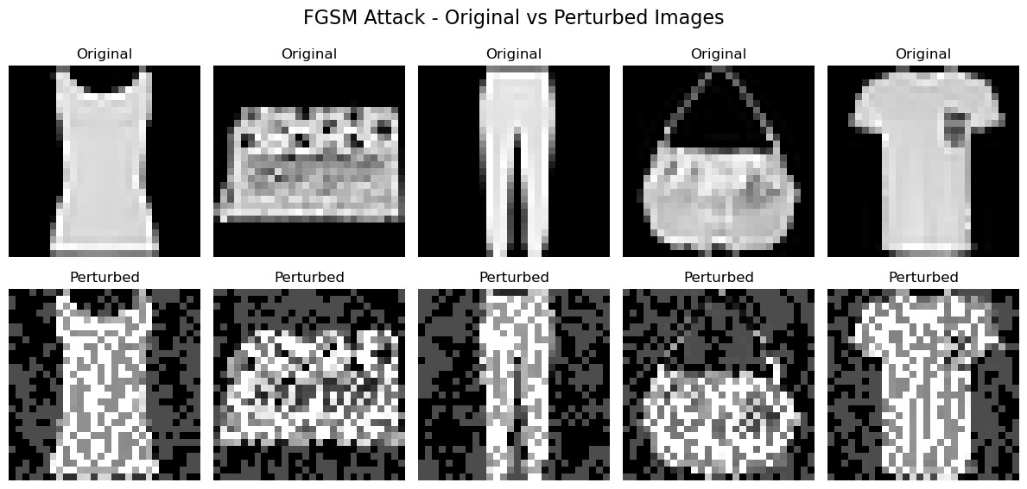
FGSM (Fast Gradient Sign Method)

Slide 4

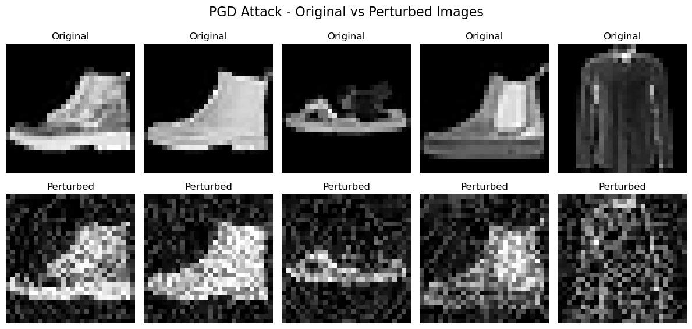
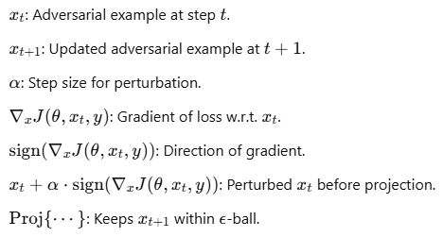
PGD (Projected Gradient Descent)
Projected Gradient Descent (PGD) is an extension of the Fast Gradient Sign Method (FGSM) that improves adversarial strength by applying multiple small FGSM steps instead of a single large step.

Slide 5
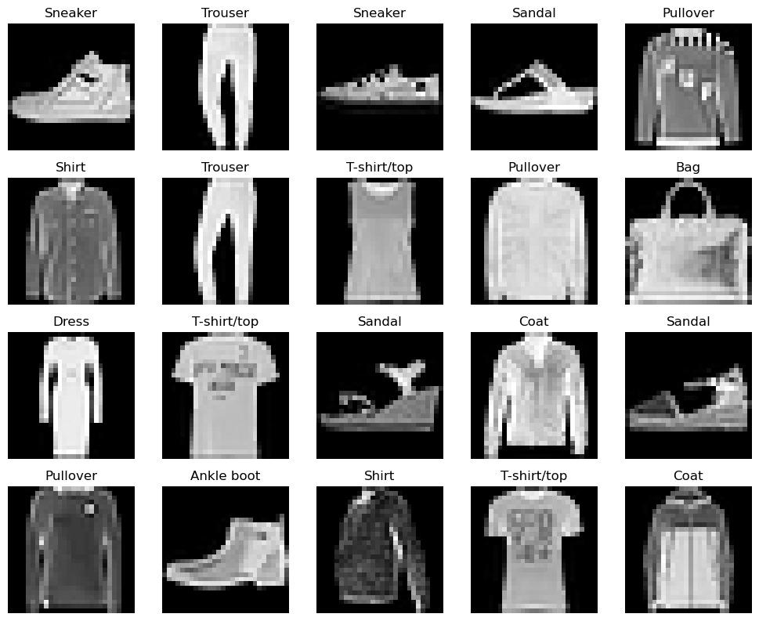
Overview of Fashion MNIST Dataset
10 classes of grayscale images (e.g., shirts, shoes, bags).
Dataset size: 60,000 training, 10,000 testing.
Example images: Display a grid of a few dataset samples.

Slide 6
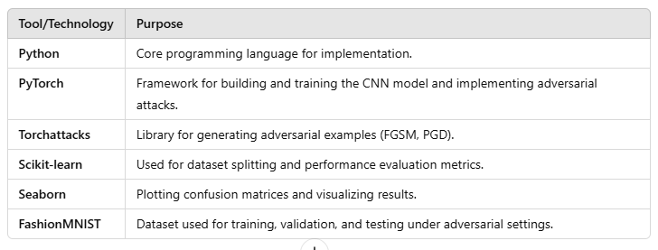
Tools and Technologies Table

Slide 7
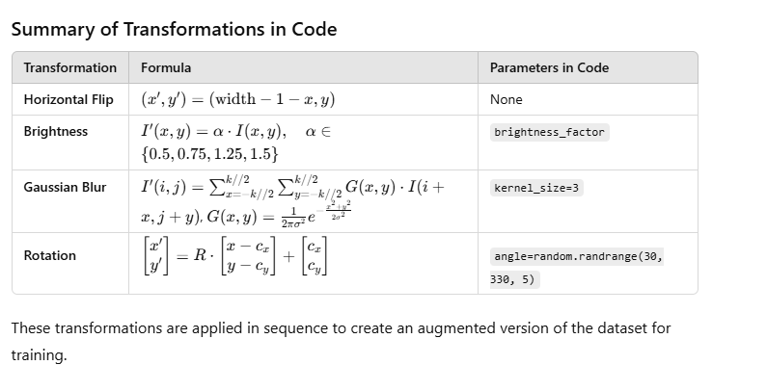
Data Augmentation

Slide 8
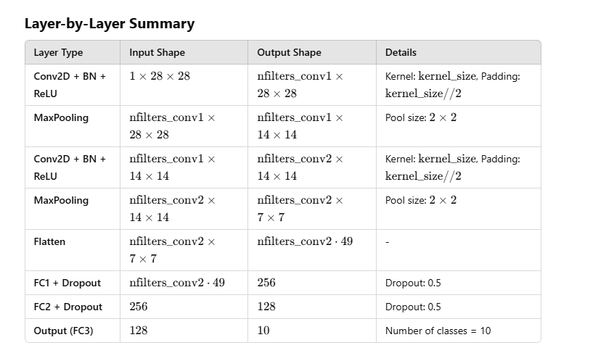
CNN Model

Slide 9
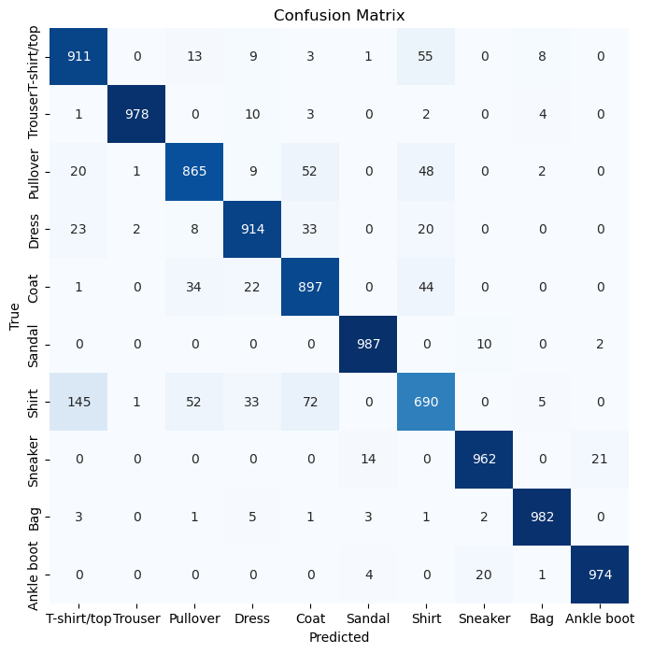
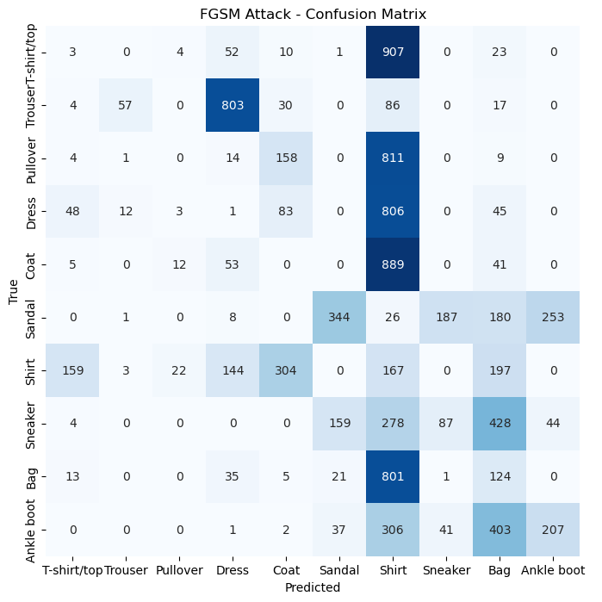
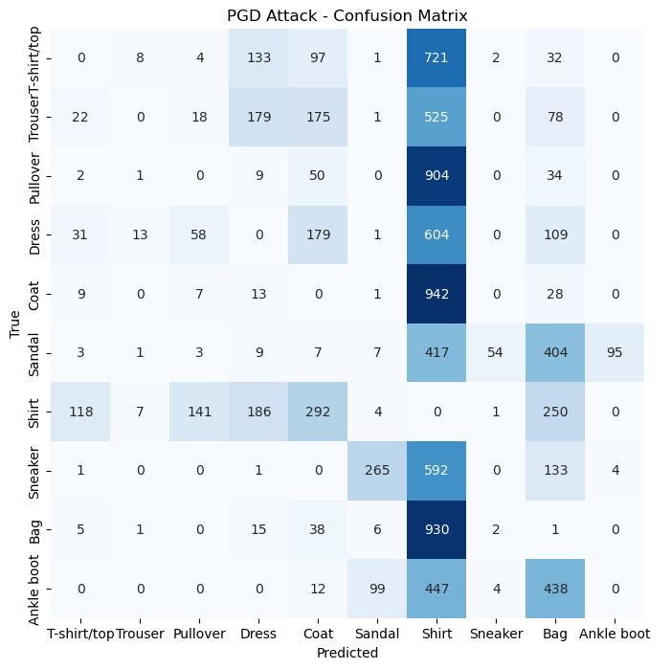
Effect of Attacks on Model
Before attack: Accuracy = 92%.
After FGSM attack (ϵ=0.3): Accuracy drops to 10%.
After PGD attack (eps=0.3, alpha=0.01, steps=10): Accuracy drops to 0.008%.

Slide 10
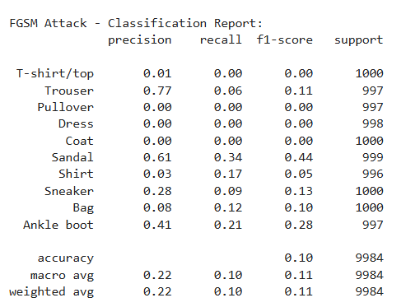
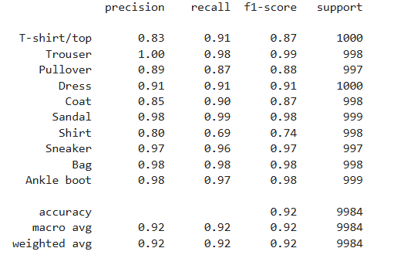
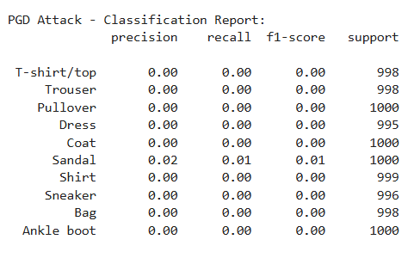

Slide 11
Mixed Adversarial Training (MAT)
Training Strategy: MAT trains the model on a mix of clean and adversarial FashionMNIST examples, generated using FGSM and PGD, ensuring resilience to perturbations.
Balanced Dataset: Each batch contains 50% clean images and 50% adversarial examples, providing a diverse input mix for effective training.

Slide 12
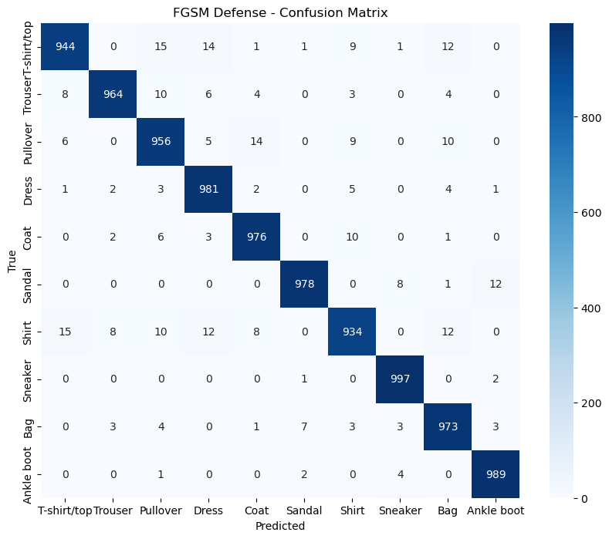
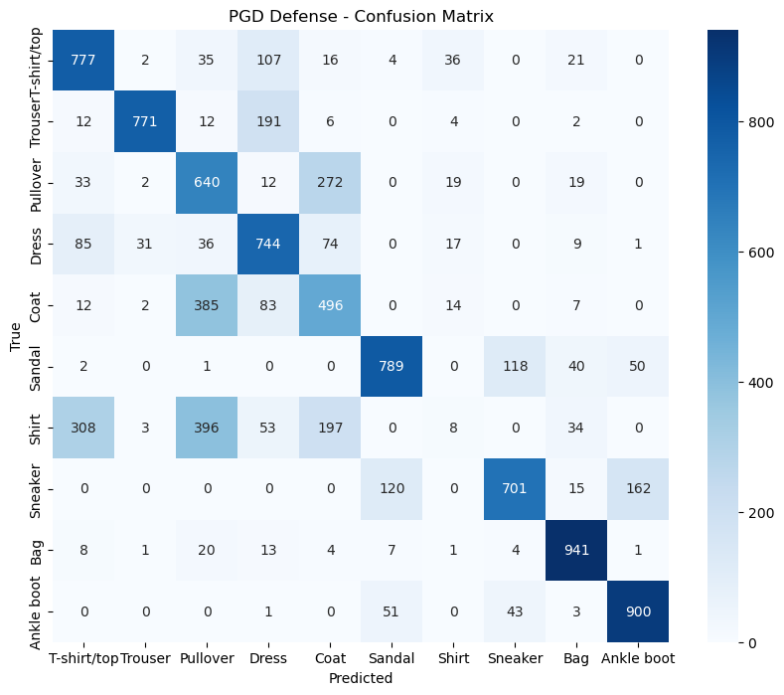
Model Performance Post-Defense
Accuracy on clean data: 91%.
Accuracy on FGSM attacks: Improved to 97%.
Accuracy on PGD attacks: Improved to 68%.

Slide 13
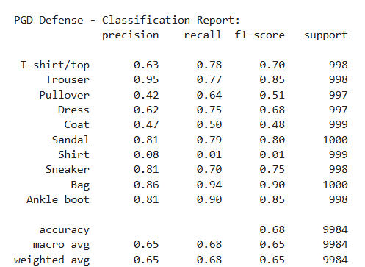
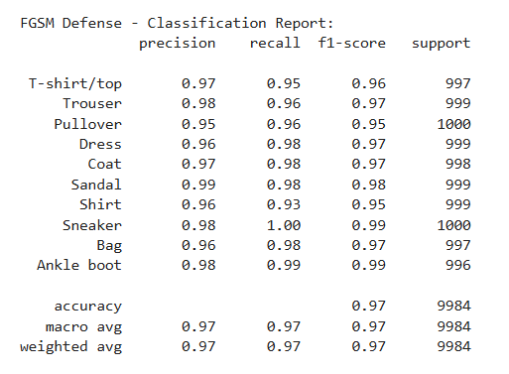

Slide 14
Limitations of Models
Limitations of FGSM and PGD
FGSM: Limited to single-step perturbation; less effective for stronger defenses.
PGD: Computationally expensive due to iterative nature.
Both: May fail against stronger, adaptive defenses.
Limitations of MAT
Increased training time due to adversarial sample generation.
Potential overfitting to specific types of adversarial attacks.

Slide 15
Conclusion
Adversarial Training Significance: The results highlight the importance of adversarial training in addressing security threats in AI, enhancing both robustness and accuracy using FGSM and PGD attacks.
Targeted Mixed Approach: By combining clean and adversarial inputs, we demonstrated how this method effectively mitigates neural network vulnerabilities, offering a solid framework for secure AI systems in adversarial settings.

